Slide 1
Basic fundamental of Networking
If Devices are in same network, they can access each other.

Slide 2
Our case
Let’s say, we are creating our services in data zone1, so other resources who are deployed in zone1 can access our resources

Slide 3
Solution
To solve this problem Azure has given VNET concept where in Data centre you can create your network.
This is also refereed as network virtualization.

Slide 4
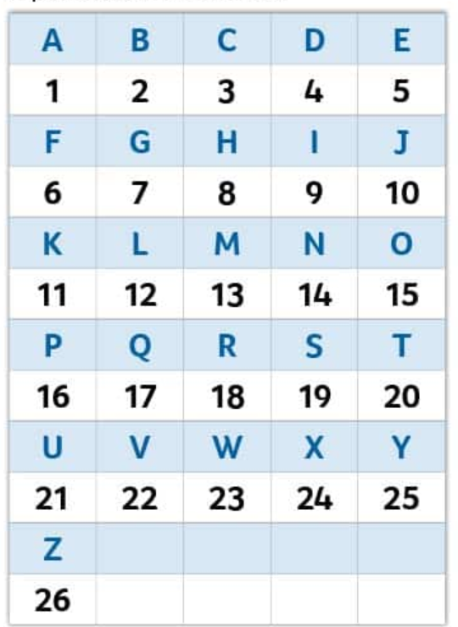
Encryption

Slide 5
I will say in number you convert words
1-2-4-4 > ABCD
In Companies we use SSL certificate to implement encryption.

Slide 6
SSL use case
Suppose, you are opening internet banking, and typing ID and password, if hacker get that he might can operate your account.
https://www.cloudflare.com/learning/ssl/what-happens-in-a-tls-handshake/

Slide 7
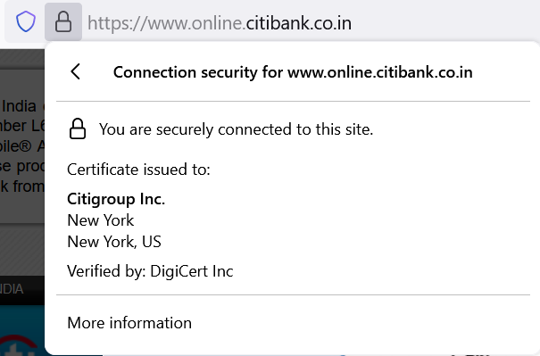
SSL certificate/TLS certificate

Slide 8
SSL certificate
SSL stands for Secure Sockets Layer, a security protocol that creates an encrypted link between a web server and a web browser. Companies and organizations need to add SSL certificates to their websites to secure online transactions and keep customer information private and secure.

Slide 9
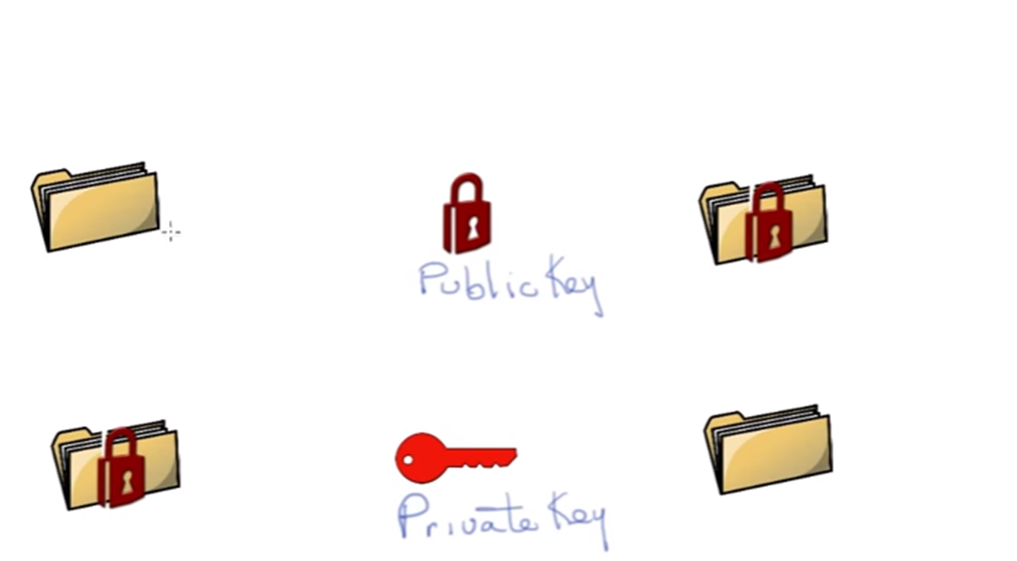
Public key Infrastructure

Slide 10
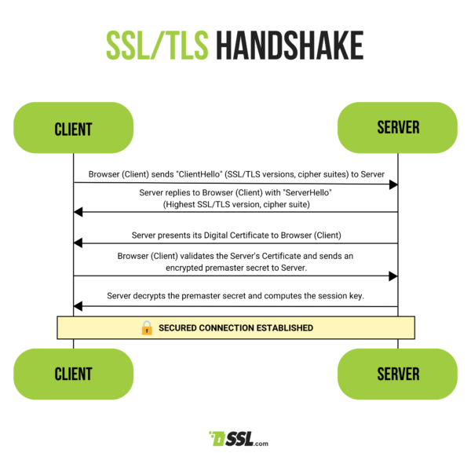
How SSL works

Slide 11
Virtual Network Encryption
Virtual network encryption allows encryption of virtual network traffic between virtual machines that communicate with each other within subnets marked as ‘Encryption Enabled.

Slide 12
What is Azure Firewall?
Azure Firewall is a cloud-native and intelligent network firewall security service that provides the best of breed threat protection for your cloud workloads running in Azure. It's a fully stateful firewall as a service with built-in high availability and unrestricted cloud scalability. It provides both east-west and north-south traffic inspection.

Slide 13
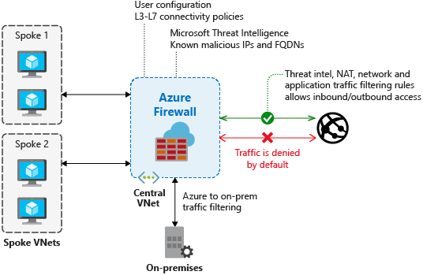

Slide 14
Example:
Allow the traffic only when source is IBM[company] network

Slide 15
What is Azure Bastion?
Azure Bastion is a fully managed PaaS service that you provision to securely connect to virtual machines via private IP address.
Example: Virtual Desktop (VDI)

Slide 16
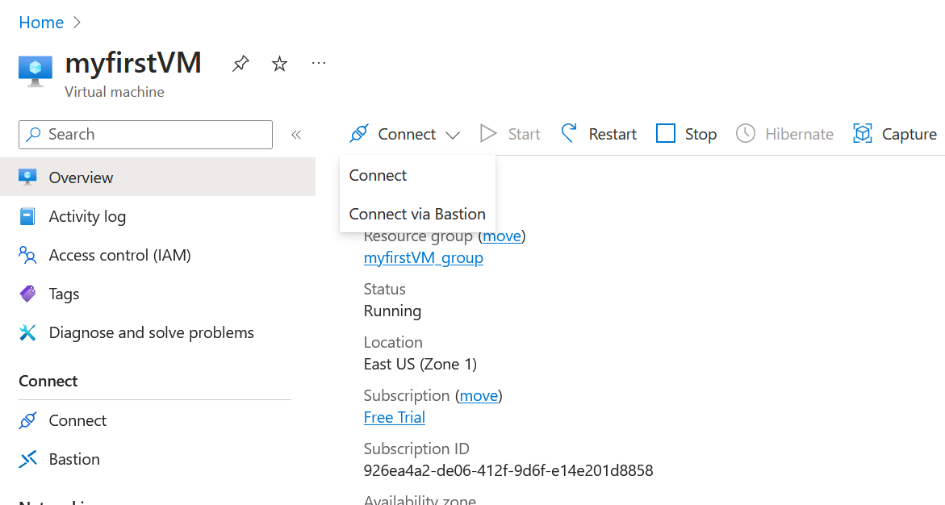

Slide 17
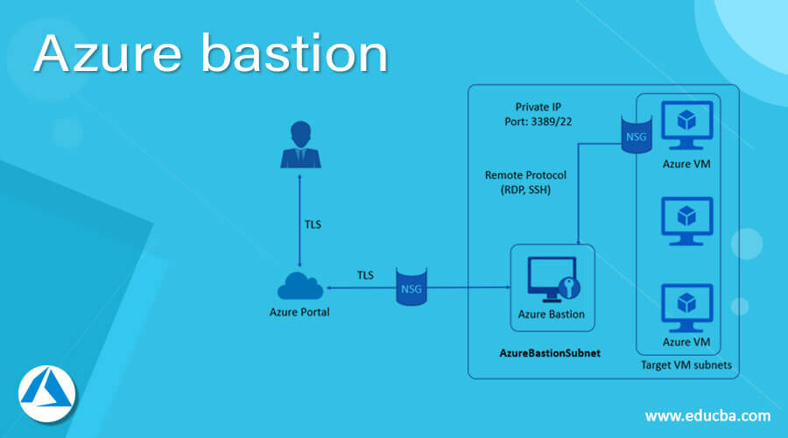

Slide 18
What is Azure DDoS Protection?
DDoS Attack means "Distributed Denial-of-Service (DDoS) Attack" and it is a cybercrime in which the attacker floods a server with internet traffic to prevent users from accessing connected online services and sites.

Slide 19
Distributed Denial-of-Service (DDoS) Attack
Let’s say Amazon is my competitor and amazon can server 100 users at a time.
Now, I would be creating a hack mechanism so I will send 5000 request to amazon, and I will not do any business.

Slide 20
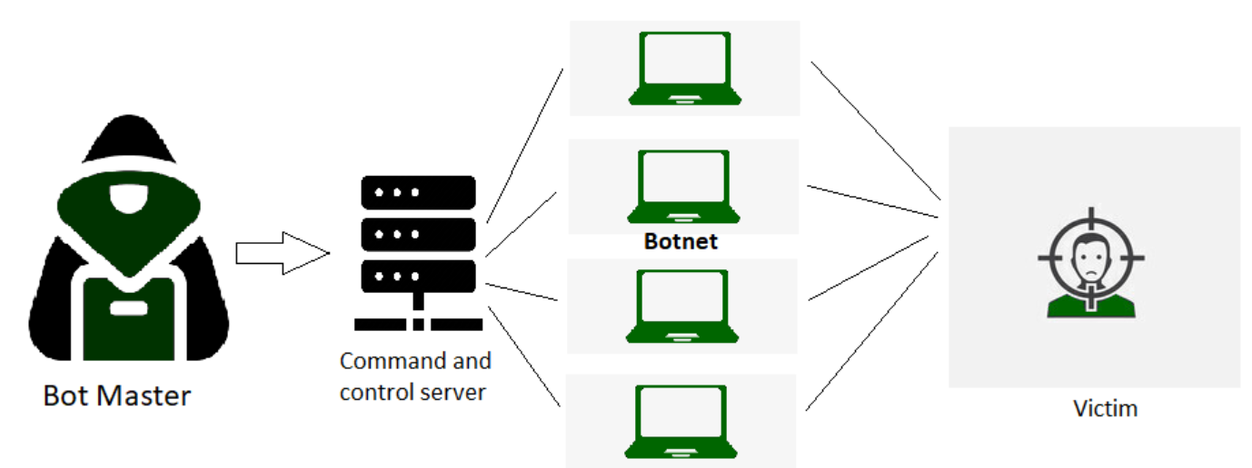
Distributed Denial-of-Service (DDoS) Attack

Slide 21
What is Azure Virtual Network?
Azure Virtual Network is a service that provides the fundamental building block for your private network in Azure. An instance of the service (a virtual network) enables many types of Azure resources to securely communicate with each other, the internet, and on-premises networks. These Azure resources include virtual machines (VMs).

Slide 22
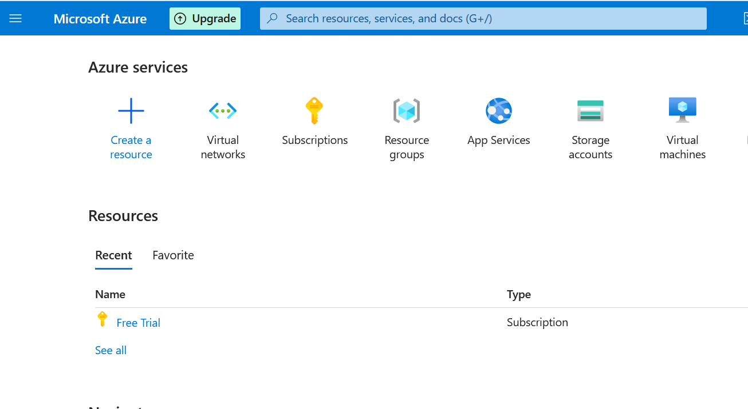

Slide 23
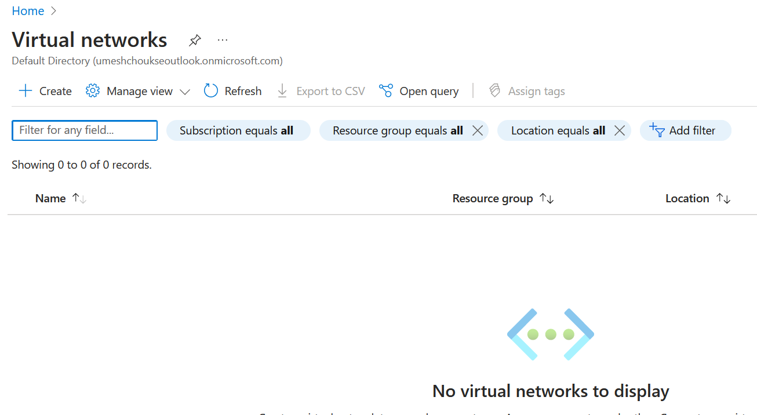

Slide 24
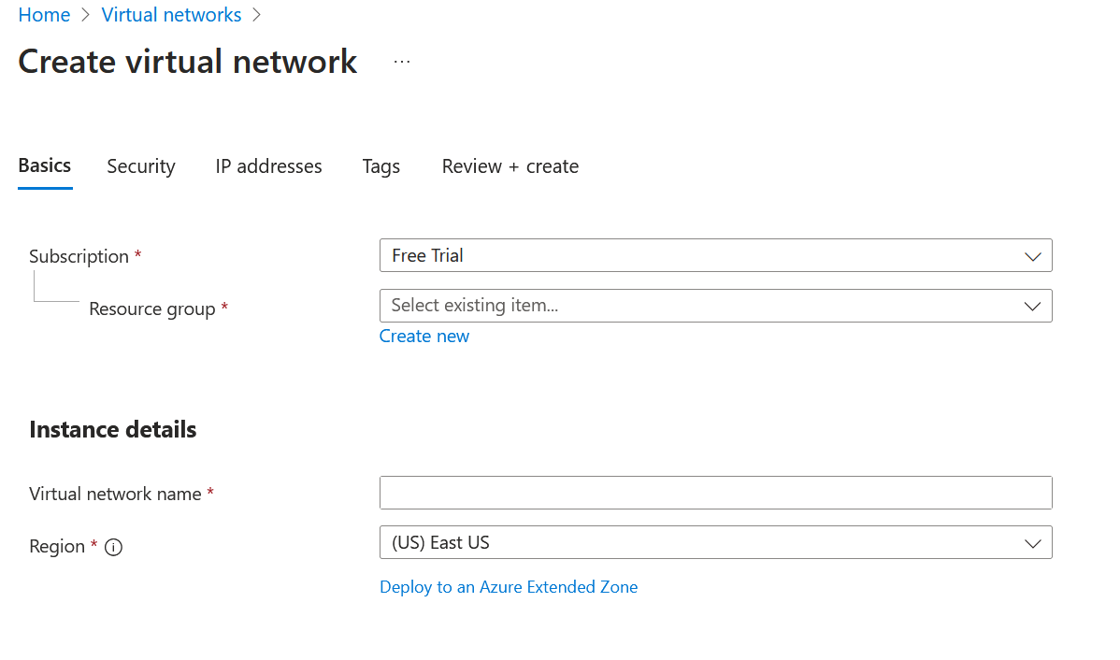

Slide 25
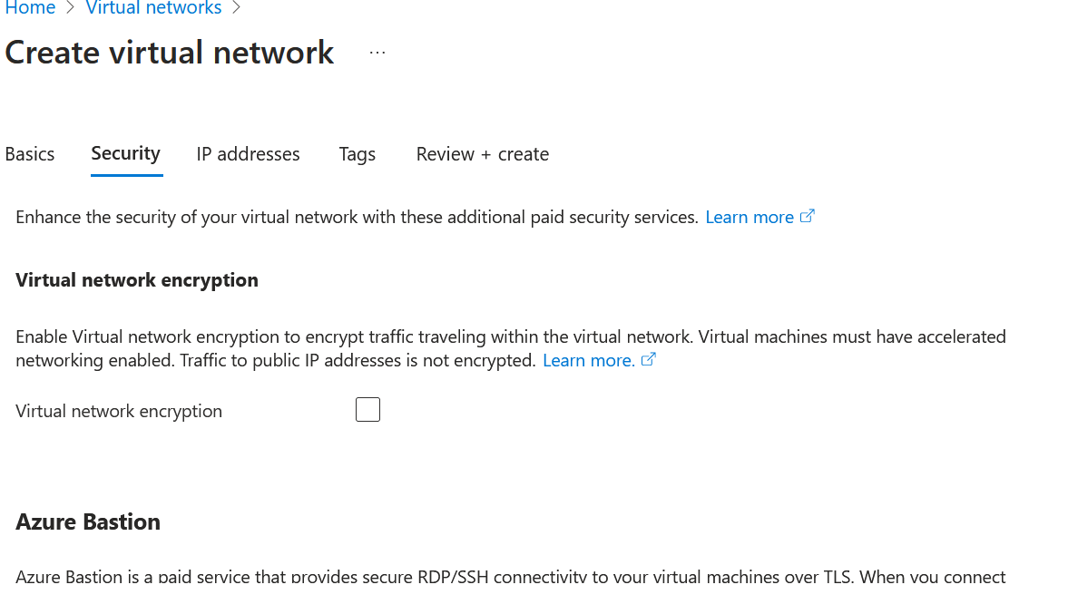

Slide 26
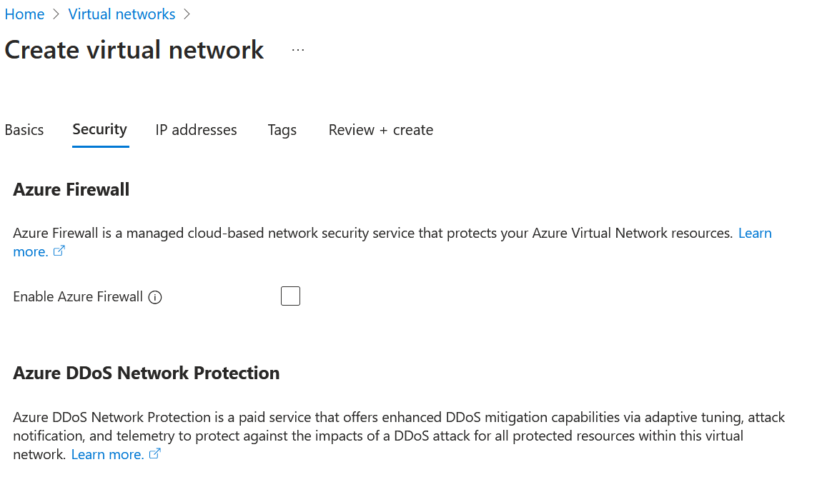

Slide 27
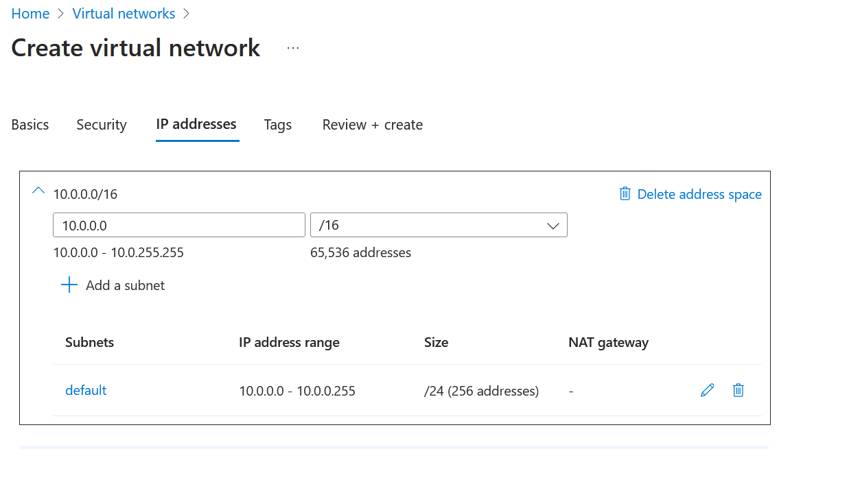

Slide 28
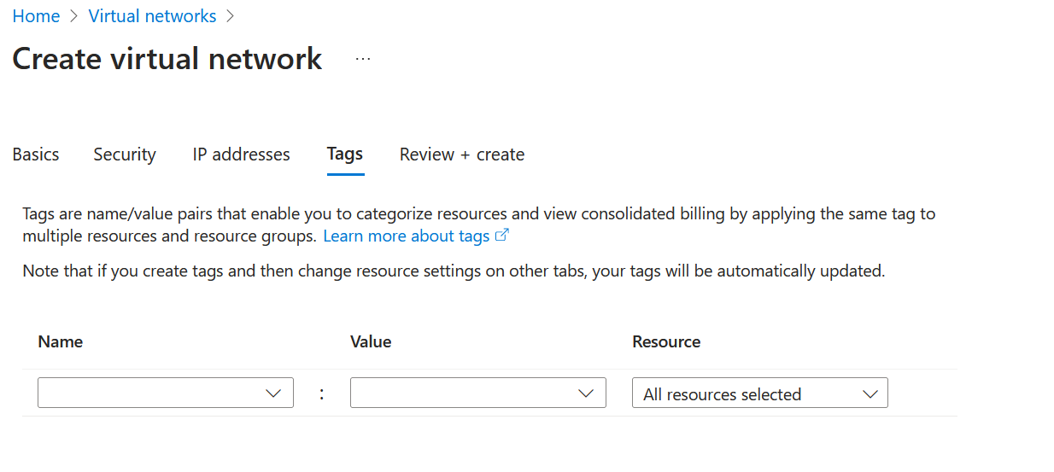

Slide 29
